Slide 1
Literature review on empathic conversational agents
Master Thesis
10-02-2022

Slide 2
Topics reviewed
How to build empathic conversational agents?
Empathic detection
Empathic response
Usage of API’s in building conversational agents
What kind of empathic conversational scenarios are being used for empathy evaluation?
Effect of light on Empathy.
How can this be applied for older adults?
Ideas for the evaluation framework.

Slide 3
Thesis Flow Chart
Literature review
Expected outcome:
decision on the empathic scenarios, ideas for experimental framework, usage of APIs
Build the backend for the empathic CA
Integrate with the chatbot
Integrate with the Tangible NESTORE
Design and perform the experiment
Design and perform the experiment
Survey with the questionnaire
Survey with the questionnaire
Collect the results
Collect the results
Compare the results
Prove for reliability of the scale
To be decided:
How to analyze, how to prove reliability,

Slide 4
Modeling Empathy in Conversational Agents
Most of the existing models of empathy fail to present a complete picture of empathic behavior.
They often model only some components of empathic capacity to avoid the complexity.
However, a computational model of empathy must reflect the theoretical background and empirical findings.
Yalçın proposed a model that reflects the theoretical background of empathy aiming Embodied Conversational Agents.

Slide 5
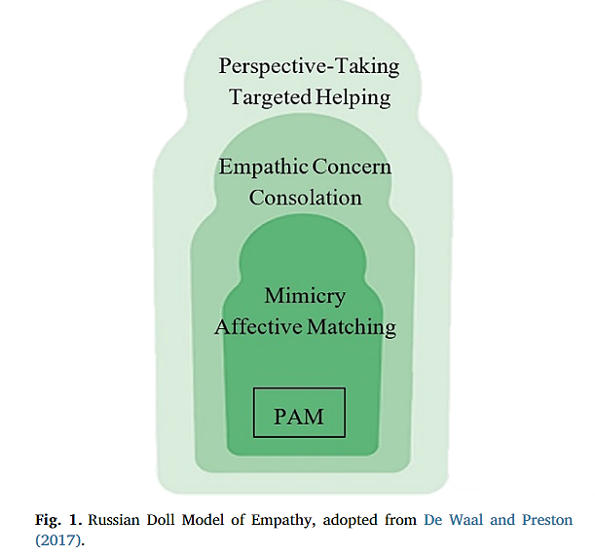
Computational Model of Empathy for Interactive Agents
It Follows the Russian Doll model of Empathy.
The framework leverages three hierarchical levels of capabilities.
Components of empathy are built on top of each other due to evolutionary mechanisms.

Slide 6
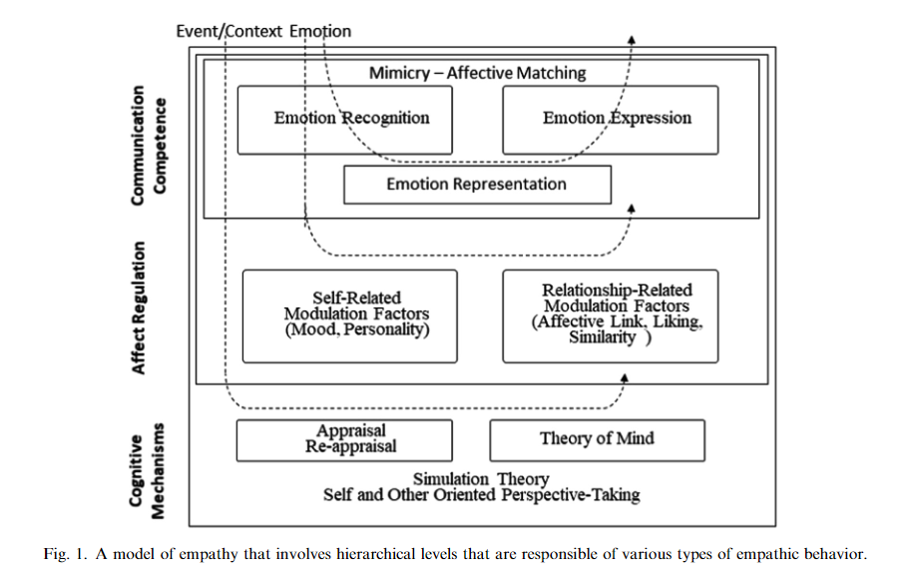
Computational Model of Empathy for Interactive Agents
Three hierarchical levels of empathic capabilities
Communication competence
Affect regulation
Cognitive mechanisms

Slide 7
Other Complete Models of Empathy for Conversational Agents
EMMA framework
A continuous representation of empathy that includes modulation mechanisms that uses mood, liking and familiarity factors to adjust the expressed empathic emotion.
CARE framework
The agent learns empathy by observing the interactions between humans in a treasure hunt game called CrystalIsland.

Slide 8
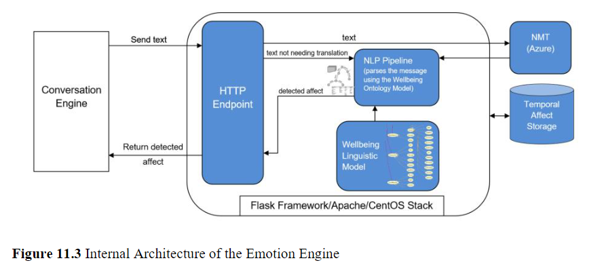
Usage of API’s in Building Conversational Agents
NESTORE Emotion Engine is an example.
Exposed through an authenticated and secured REST API service.

Slide 9
Chatbot for Self-compassion
Question “when bots have psychological issues, can humans care for them, and if so, how?”
Exploratory results on:
How caring for a chat-bot can help people more so than being cared by a chatbot.
How aiming for an increase in self-compassion can potentially strengthen psychological well-being.
Compared between care-giving (CG) and care-receiving (CR) Vincents.

Slide 10
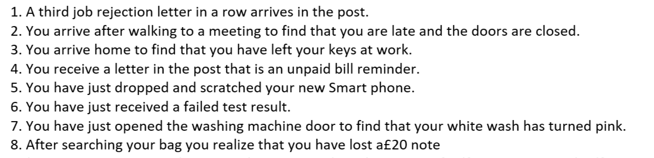
Empathic Scenarios for Building Conversations
Scenarios from Self-Compassion and Self-Criticism scale.
Examples: job rejections, unpaid bill reminders, and being late to the meeting.

Slide 11
Effect of Light on Empathy
The presence of light has an impact on mood and well being.
Various colors of light can also have a different effect on the mood and the emotions.
Blue light reduces the negative stress (distress).
Not much inputs about using the different intensities of light.

Slide 12
Effect of other modalities on Empathy
Combination of modalities is an interesting aspect.
Combining color with planar motion offered the overall best cost/benefit ratio.
Best modalities for basic emotions
Joy - color and motion
Sadness – sound
Fear - motion
Anger - color.
Color has an impact on age. However, effect of light on age is not proven.

Slide 13
Empathic Evaluation in Older Adults
Film clips are capable of evoking positive and negative emotions in older adults.
Older adults experienced more intensely negative emotions than young adults, especially in response to disgust and fear clips.
Also, the older adults recovered more easily from the effects of the emotion induction.
Fernández-Aguilar et al., has a good methodology for evaluating older people using films.

Slide 14
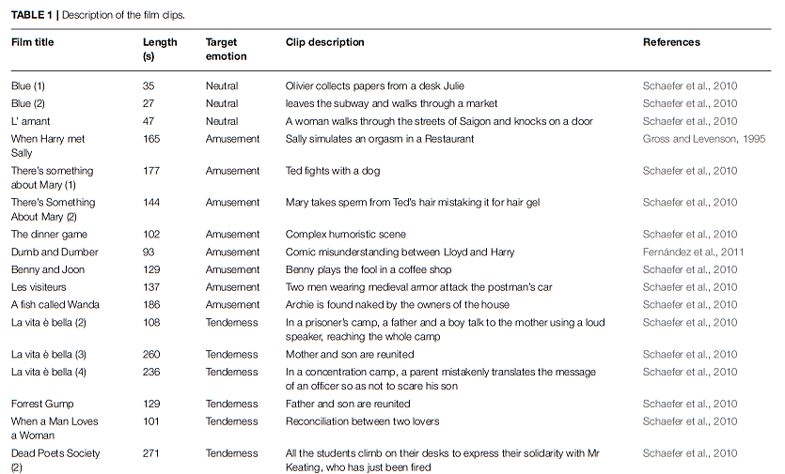
Empathic Evaluation in Older Adults
A few videos used by Fernández-Aguilar et al.

Slide 15
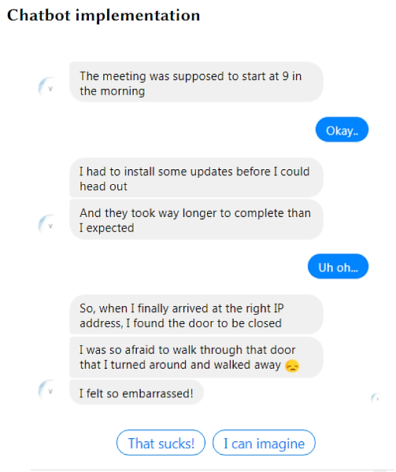
Additional Ideas for Chatbot
Using limited pre-set of responses.
Using emojis as visual icons are widespread in digital messaging to express emotions.

Slide 16
References
Boukricha, H., Wachsmuth, I., Carminati, M. N., & Knoeferle, P. (2013). A computational model of empathy: Empirical evaluation. Proceedings - 2013 Humaine Association Conference on Affective Computing and Intelligent Interaction, ACII 2013, 1–6. https://doi.org/10.1109/ACII.2013.7
Casas, J., Spring, T., Daher, K., Mugellini, E., Khaled, O. A., & Cudré-Mauroux, P. (2021). Enhancing Conversational Agents with Empathic Abilities. Proceedings of the 21st ACM International Conference on Intelligent Virtual Agents, IVA 2021, 41–47. https://doi.org/10.1145/3472306.3478344
Daher, K., Fuchs, M., Mugellini, E., Lalanne, D., & Abou Khaled, O. (2020). Reduce Stress Through Empathic Machine to Improve HCI. Advances in Intelligent Systems and Computing, 1152 AISC, 232–237. https://doi.org/10.1007/978-3-030-44267-5_35
Falconer, C. J., King, J. A., & Brewin, C. R. (2015). Demonstrating mood repair with a situation-based measure of self-compassion and self-criticism. Psychology and Psychotherapy: Theory, Research and Practice, 88(4), 351–365. https://doi.org/10.1111/papt.12056
Fernández-Aguilar, L., Ricarte, J., Ros, L., & Latorre, J. M. (2018). Emotional differences in young and older adults: Films as mood induction procedure. Frontiers in Psychology, 9. https://doi.org/10.3389/fpsyg.2018.01110
Lee, M., Ackermans, S., van As, N., Chang, H., Lucas, E., & IJsselsteijn, W. (2019, May 2). Caring for Vincent: A Chatbot for Self-compassion. Conference on Human Factors in Computing Systems - Proceedings. https://doi.org/10.1145/3290605.3300932
Löffler, D., Schmidt, N., & Tscharn, R. (2018). Multimodal Expression of Artificial Emotion in Social Robots Using Color, Motion and Sound. ACM/IEEE International Conference on Human-Robot Interaction, 334–343. https://doi.org/10.1145/3171221.3171261
McQuiggan, S. W., & Lester, J. C. (2007). Modeling and evaluating empathy in embodied companion agents. International Journal of Human Computer Studies, 65(4), 348–360. https://doi.org/10.1016/j.ijhcs.2006.11.015
Scotti, V., Tedesco, R., & Sbattella, L. (2021). A modular data-driven architecture for empathetic conversational agents. Proceedings - 2021 IEEE International Conference on Big Data and Smart Computing, BigComp 2021, 365–368. https://doi.org/10.1109/BigComp51126.2021.00080
Sykora, M., Elayan, S., Angelini, L., Röcke, C., el Kamali, M., Mugellini, E., & Guye, S. (n.d.). Chapter 11. Understanding older adults’ affect states in daily life for promoting self-reflection about mental wellbeing. https://www.w3.org/TR/owl-features/.
Yalcin, O. N., & Dipaola, S. (2018). A computational model of empathy for interactive agents. Biologically Inspired Cognitive Architectures, 26, 20–25. https://doi.org/10.1016/j.bica.2018.07.010
Yalçın, O. N. (2018). Modeling empathy in embodied conversational agents. ICMI 2018 - Proceedings of the 2018 International Conference on Multimodal Interaction, 546–550. https://doi.org/10.1145/3242969.3264977
Yalçın, Ö. N. (2020). Empathy framework for embodied conversational agents. Cognitive Systems Research, 59, 123–132. https://doi.org/10.1016/j.cogsys.2019.09.016

Slide 17
Thank You!

